Slide 1
Understanding Trends in Property Market Value
Real Estate Agency

Slide 2
BUSINESS UNDERSTANDING
Introduction
Objective: Providing comprehensive services to homeowners looking to buy or sell their properties.
Focus: Advising homeowners on potential renovations to increase property value.
Importance: Informed decisions crucial for favorable return on investment (ROI).
Stakeholder
Audience: Real Estate Agency
Interest: Ensuring efficient and effective services for homeowners.
Need: Insight into factors influencing property value increase.

Slide 3
BUSINESS UNDERSTANDING
Problem Statement
Challenge: Lack of an efficient method to understand factors influencing property value increase.
Consequence: Suboptimal advice may lead to dissatisfaction or loss of value for homeowners.
Need: Develop data-driven solution for accurate prediction of renovation impact.

Slide 4
OBJECTIVES
Analyze Property Attributes
Focus: Understanding the relationship between property attributes and house prices.
Key Attributes: Lot area, number of bedrooms, grade, condition, etc.
Identification: Identifying the most and least influential factors on house prices.
To do:
Provide Insights: Offer insights on how property attributes impact property value.
Tailored Guidance: Tailored and informed recommendations for homeowners in King City County.

Slide 5
RESEARCH QUESTIONS
What is the combined influence of structural features, location, and temporal factors on the market price of houses?
how can we optimally model these relationships to predict housing prices with high accuracy?
Lot Size and Grades: Is there a statistically significant difference in lot size (sqft_lot) among houses with varying grades?
Waterfront View Impact: Do houses with a waterfront view have a significantly higher average price compared to houses without a view?
Bedrooms and Bathrooms: To what extent does the combined influence of bedrooms and bathrooms affect the price of a house?

Slide 6
VALUE TO STAKEHOLDERS
Accurate Pricing Estimates: Understanding the combined influence of factors allows the Real Estate Agency to provide accurate pricing estimates to homeowners, enhancing customer satisfaction and trust.
Tailored Advice: Analysis of lot size, waterfront views, and bedroom-bathroom combinations enables the agency to offer tailored advice to homeowners, maximizing property value and market competitiveness.

Slide 7
CORRELATION ANALYSIS
Correlation Insights
Strong Predictor: 'sqft_living' exhibits the highest correlation with 'price', indicating that the size of the living area strongly influences the price of a house.
Quality Matters: Features like 'grade' and 'sqft_above' also demonstrate significant positive correlations with 'price', suggesting that overall quality and living space contribute substantially to house pricing.
Location Impact: The geographic coordinates (latitude and longitude) show the least correlation with 'price', implying that location alone, as indicated by coordinates, has a weaker association with house price in this dataset.

Slide 8
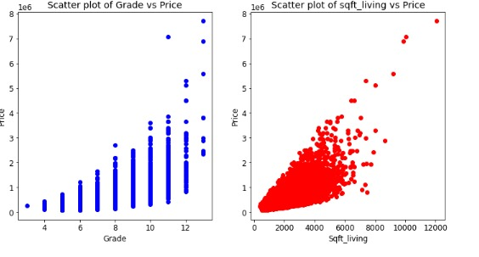
CORRELATION ANALYSIS
Strong Predictor: From the graph we see that; as the squarefoot living increases the price of the house also increases. Increase in grade of the house also increases the hous prices

Slide 9
MODEL PERFORMANCE AND COEFFICIENTS INTERPRETATION
Overall Model Significance: Our analysis shows that our model is highly effective at predicting house prices. It means that the things we looked at together can explain around 62.9% of why house prices are different.
Significance of Coefficients: Every factor we looked at – like the size of the living area, number of bedrooms, and year the house was built – has a real impact on how much a house costs. Each one is significant in helping us understand and predict house prices.

Slide 10
MODEL PERFORMANCE AND COEFFICIENTS INTERPRETATION
Interpretation of Coefficients:
Starting Price: Even if a house had no extra features, it would still be priced at around $22.
Living Area: For every extra square foot of living area, the price goes up by about $0.002.
Bathrooms: Adding another bathroom increases the price by approximately $0.1067.
Bedrooms: Each additional bedroom adds about $0.0185 to the price.
Year Built: Interestingly, as houses get older, their prices tend to drop slightly by around $0.0062 per year.
Grade, Views, and Waterfront: Higher grade ratings, better views, and waterfront locations significantly increase house prices, by $0.2430, $0.0582, and $0.3476 respectively.

Slide 11
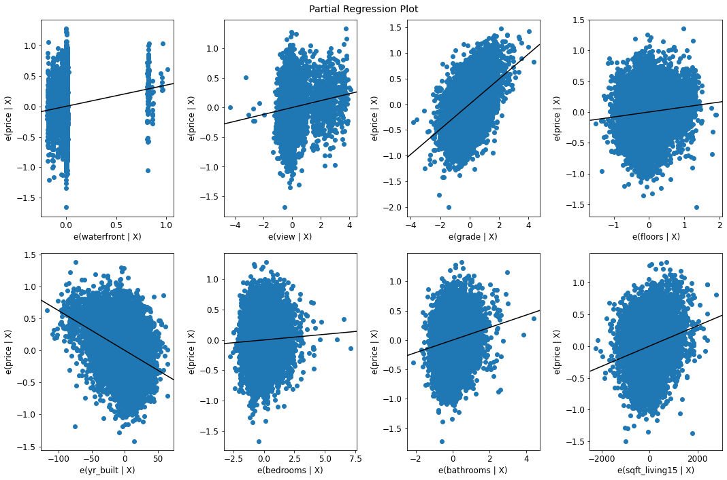

Slide 12
POLYNOMIAL REGRESSION ANALYSIS
Introduction: Polynomial regression is a fancy way of saying we're exploring if a curve (not just a straight line) fits our data better than before. We want to see if this curve can predict house prices more accurately.
Model Building: We built a special type of model that looks at our data and tries to find the best curve that describes how different factors affect house prices.
Model Evaluation: We checked how well our model performs using two simple tests:
Root Mean Squared Error (RMSE): Measures how close predicted prices are to real prices. For polynomial model, RMSE was about 0.309, meaning it's pretty accurate.
R-squared (R²): Tells how much of the price differences our model can explain. Our polynomial model explained around 64.9% of why prices vary, which is pretty good.

Slide 13
POLYNOMIAL REGRESSION ANALYSIS
Comparison with Linear Regression:
Our polynomial model's error (0.309) was lower than before (0.319), showing it's better at predicting prices accurately.
Plus, our polynomial model explained more of the price differences (64.9%) compared to before (63%).
Based on these tests, it's clear that our polynomial model is a better fit for our data. It predicts house prices more accurately and explains more about why prices differ. So, it's a smarter choice for us when understanding house prices.

Slide 14
POLYNOMIAL REGRESSION ANALYSIS
The residual plots below show us the differences between the predicted values and the actual values.
It is evident that our models performed well since the data points are closer to zero.

Slide 15
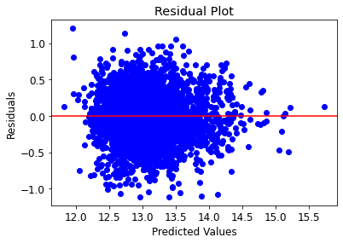
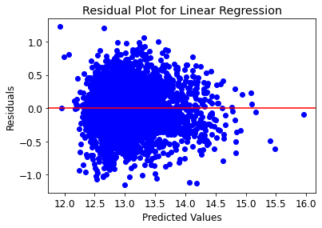
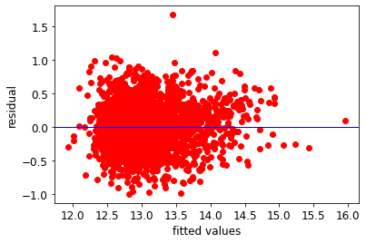
Regression model

Slide 16
RECOMMENDATIONS
Comprehensive Value Drivers: Property value extends beyond the physical space, being significantly influenced by structural integrity, prime location, and year of construction market.
Quality and Lot Size Connection: A property's condition directly correlates with its lot size, highlighting the importance of upkeep and modernization in enhancing market value.
Premium on Waterfront Views: Properties boasting waterfront views command higher market prices, representing a lucrative investment for buyers and a unique selling proposition for owners.
Optimal Bedrooms and Bathrooms Mix: The combination of bedrooms and bathrooms significantly impacts house pricing, guiding strategic property selection for buyers and effective marketing for sellers.

Slide 17
RECOMMENDATIONS
The shareholder should encourage homeowners to do renovations so as to improve the overall condition and raise the property's grade as this has a great impact on the value of a house.
There is also high impact of square footage of living space on house prices and use this information to justify higher listing prices for properties with more extensive square footage.
The number of bathrooms and bedrooms also have a positive correlation with the value of a house. Therefore, during renovation adding a bedroom would increase the value of the house!
For price prediction of the houses, we recommend use of Polynomial regression model as it gives a high R- squared value which means that we can get a better and more accurate price value.

Slide 18
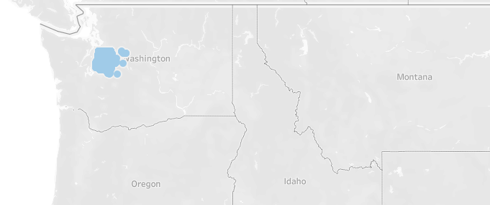
LIMITATIONS
Geographical Focus: The dataset only covers the Northeastern region, limiting its usefulness for predicting housing prices nationwide. This means our findings might not apply to other areas of the country.
Multicollinearity: We found that some variables in our dataset are strongly related to each other. This can make our predictions biased or inaccurate.

Slide 19
CONCLUSION
Understanding regional trends and economic factors is crucial for predictive modeling in real estate.
Adoption of sophisticated frameworks and high-quality data is essential for accuracy and robustness.
This research offers valuable insights for policymakers and investors, enhancing urban development strategies.

Slide 20
Thank You!
Q & A

